Slide 1
Hidden gems in Lebanon
Presented by: Jenny chahine & Rebecca fadous
Presented to: Mrs Suzy Kerellos

Slide 2
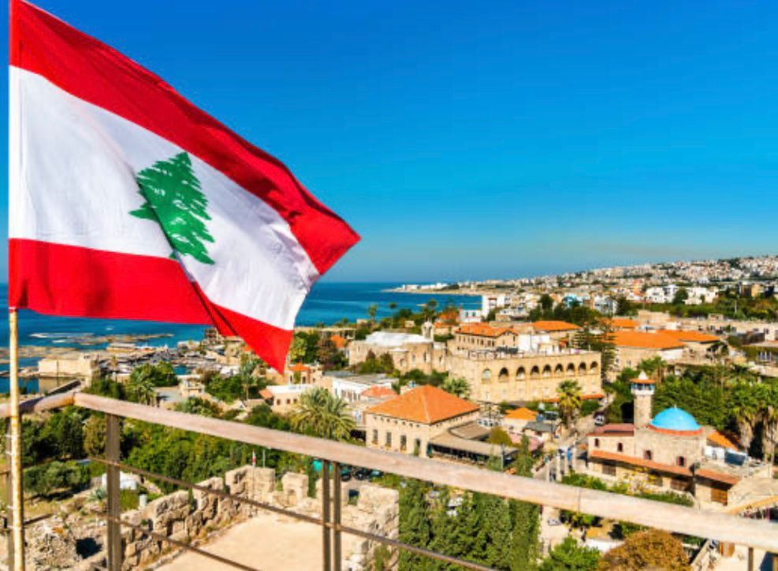
Hello everyone. Today Jenny and I are going to show you the other side of Lebanon away from political, economical and social crisis. We are going to discuss some unpopular regions of Lebanon.

Slide 3
Outline:
conclusion
Introduction
Ammiq
Beit
chabeb
Rachana

Slide 4
Rachana
From Candles, Dust and Mud to a Special Art

Slide 5
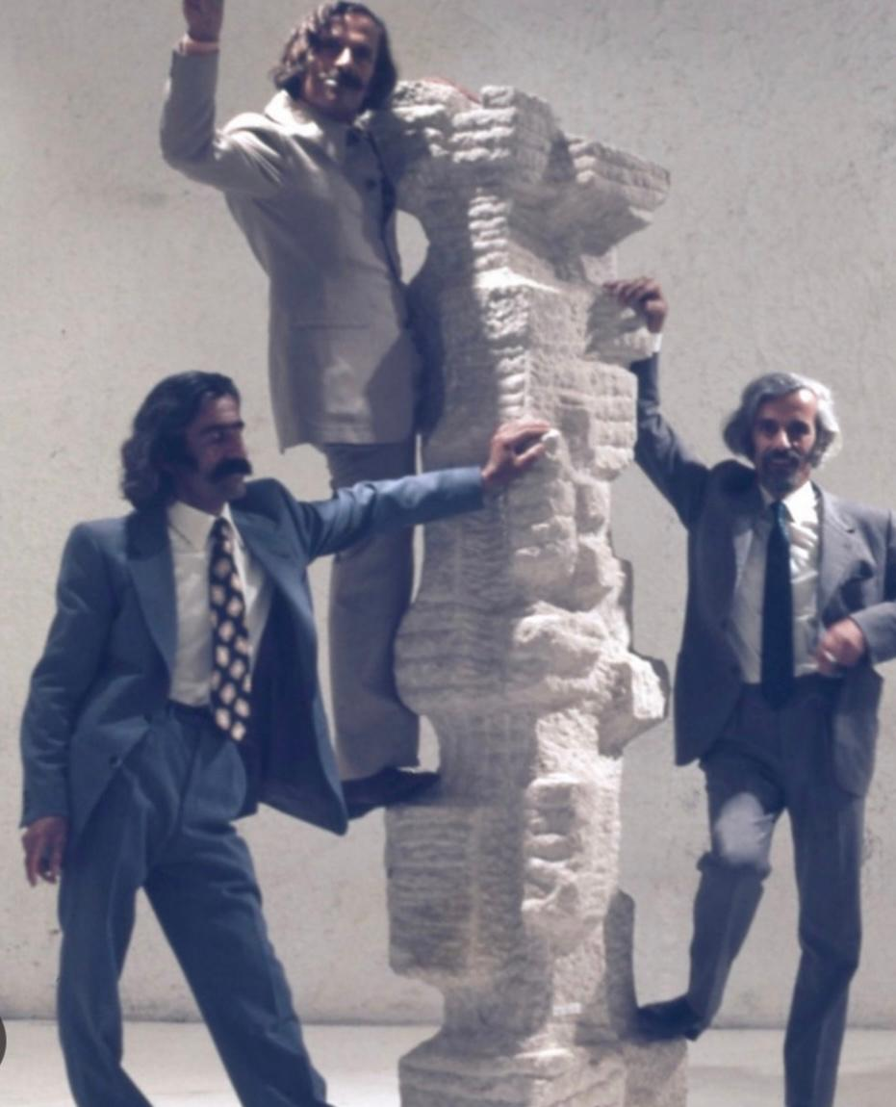
RACHANA
Located in Batroun district, Rachana is known for the sculptures made by the Basbous family: Michel, Alfred and Youssef, the three brothers who started the path of success. They turned the village into a workshop where they spread their art on the side of the street.

Slide 6
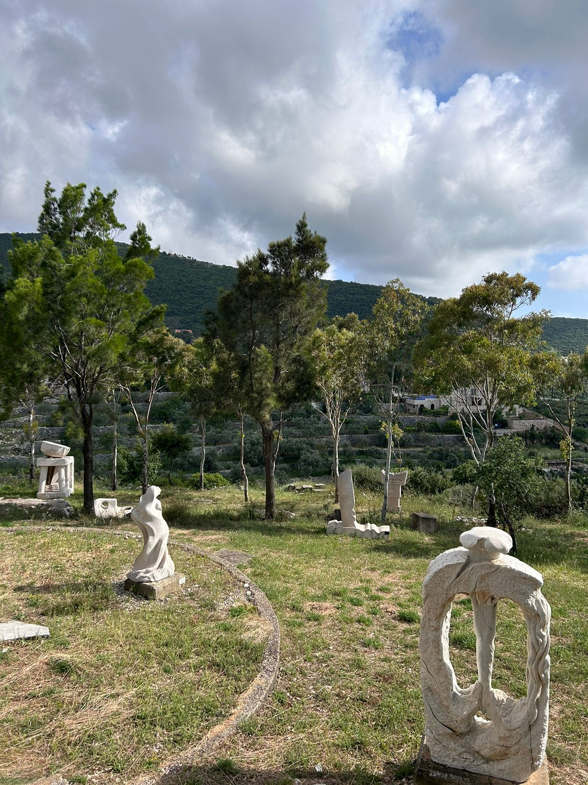
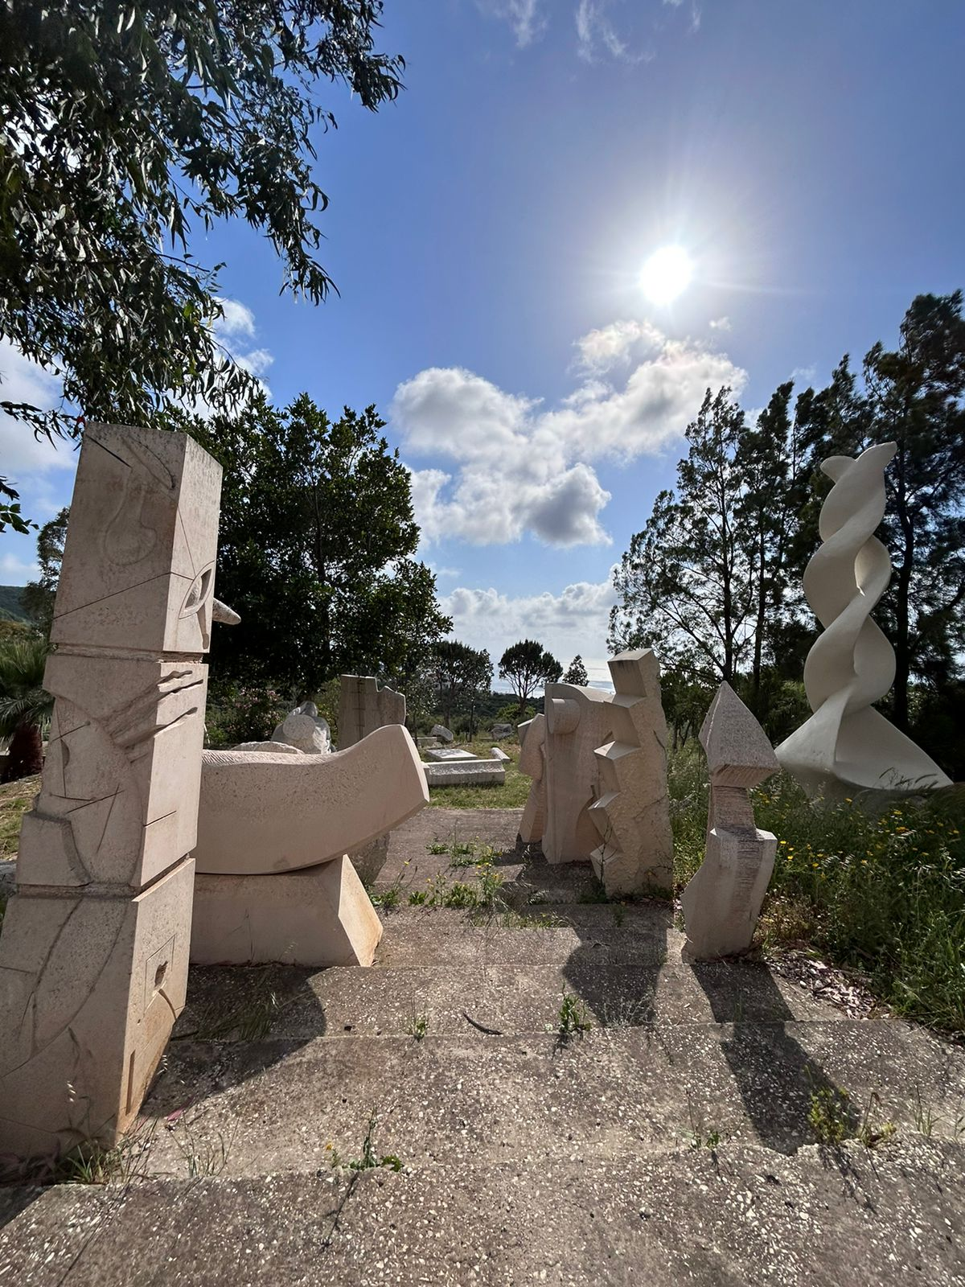
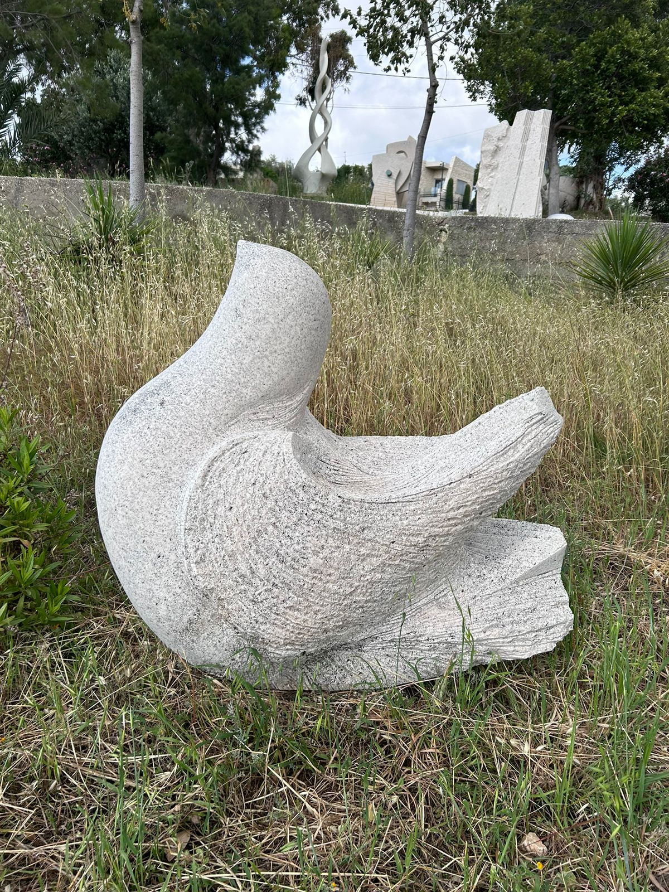
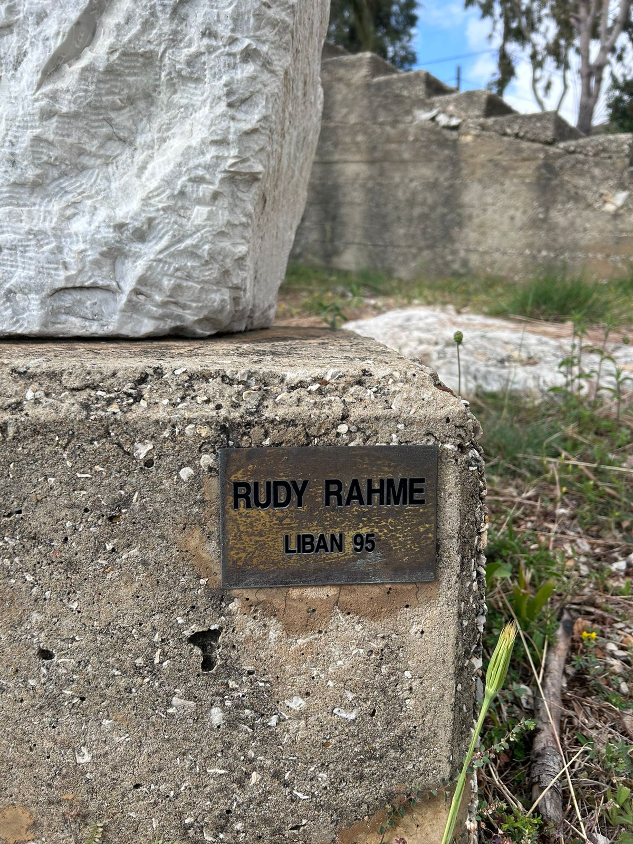
In 1994, Alfred, Youssef and Michel Basbous hosted a number of international sculptors, from various nationalities, in Rachana. It was within the project of the “International workshop of sculpture” whereby these sculptors left their works in the village and each artist signed his sculpture. This place became a free park for visitors. Consequently, Rachana was labeled as “Open air museum” by the Unesco in 1997.

Slide 7
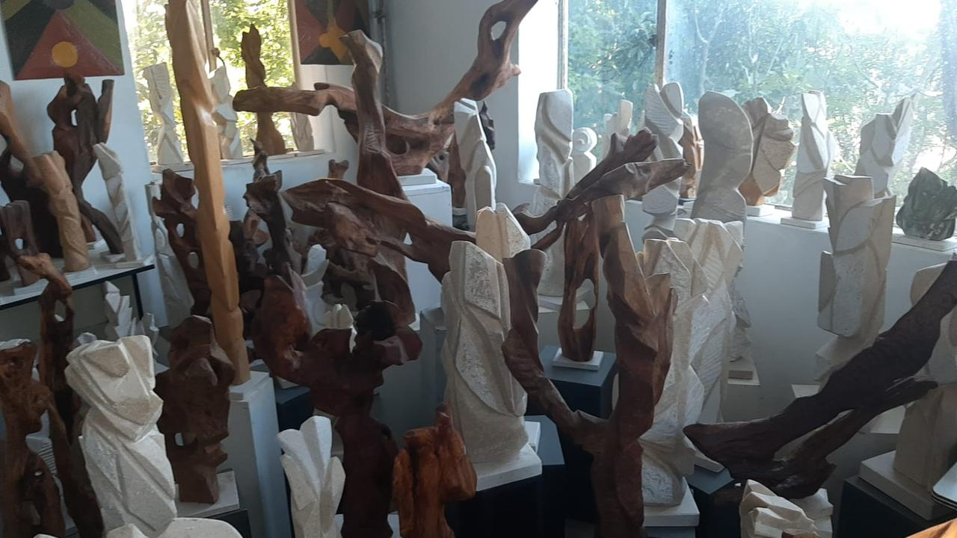
The sons of Michel, Youssef and Alfred continued what their parents started and even elaborated the work. For example:
Samir Youssef Basbous has his own workshop where he sells his sculptures
His brother Nabil is known for sculpting people’s face such as Elias El Hrawi and Bechara El Khoury, two previous presidents of the republic.

Slide 8
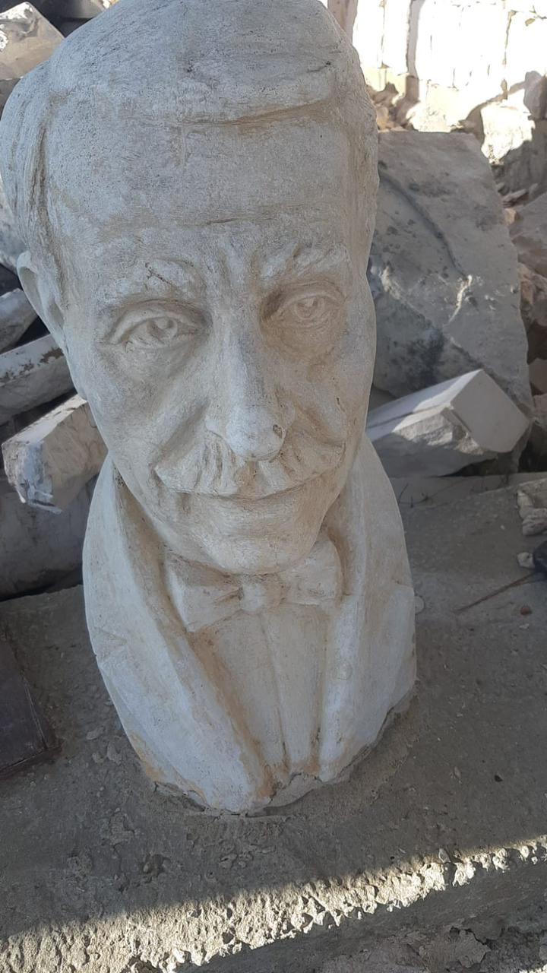
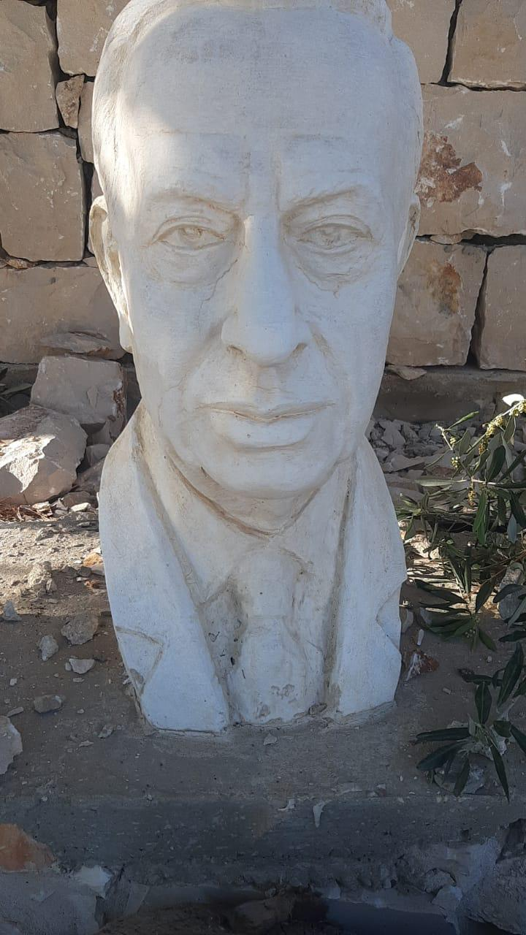
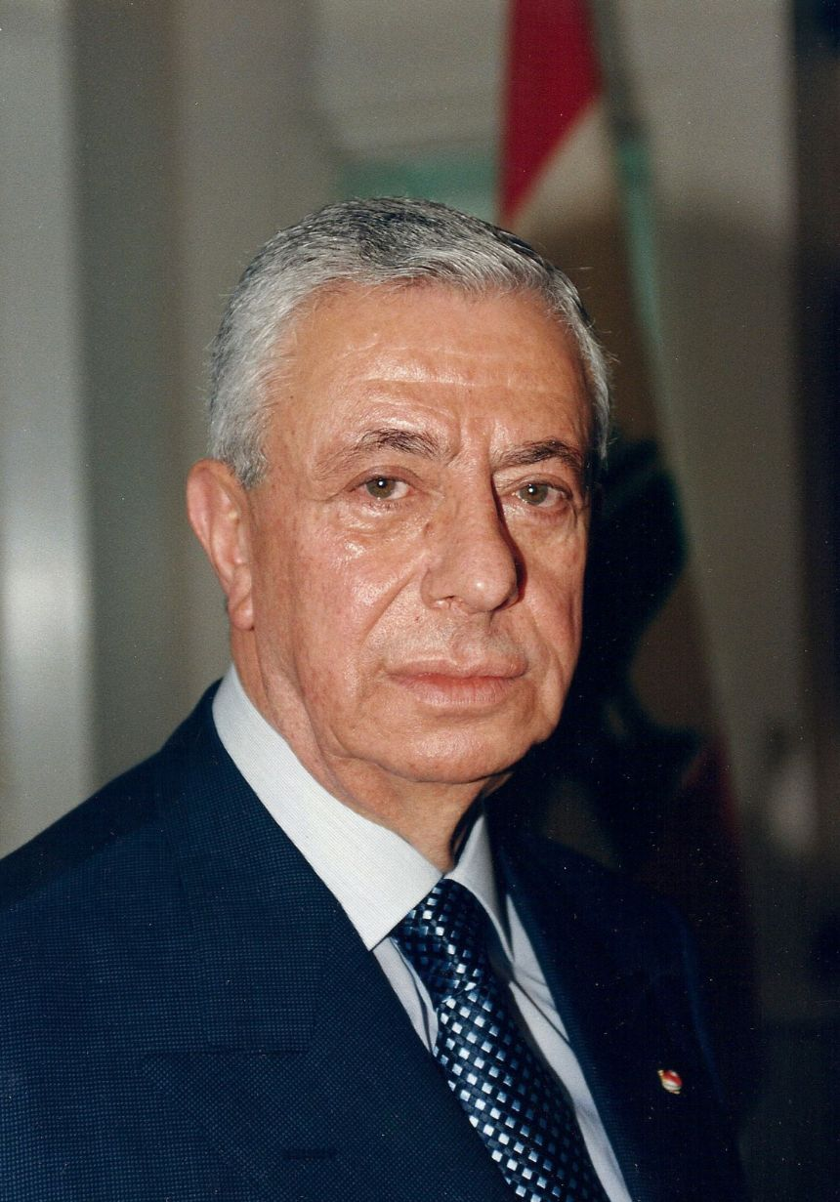
Nabil’s work
Bechara El Khoury
Elias El Hrawi

Slide 9
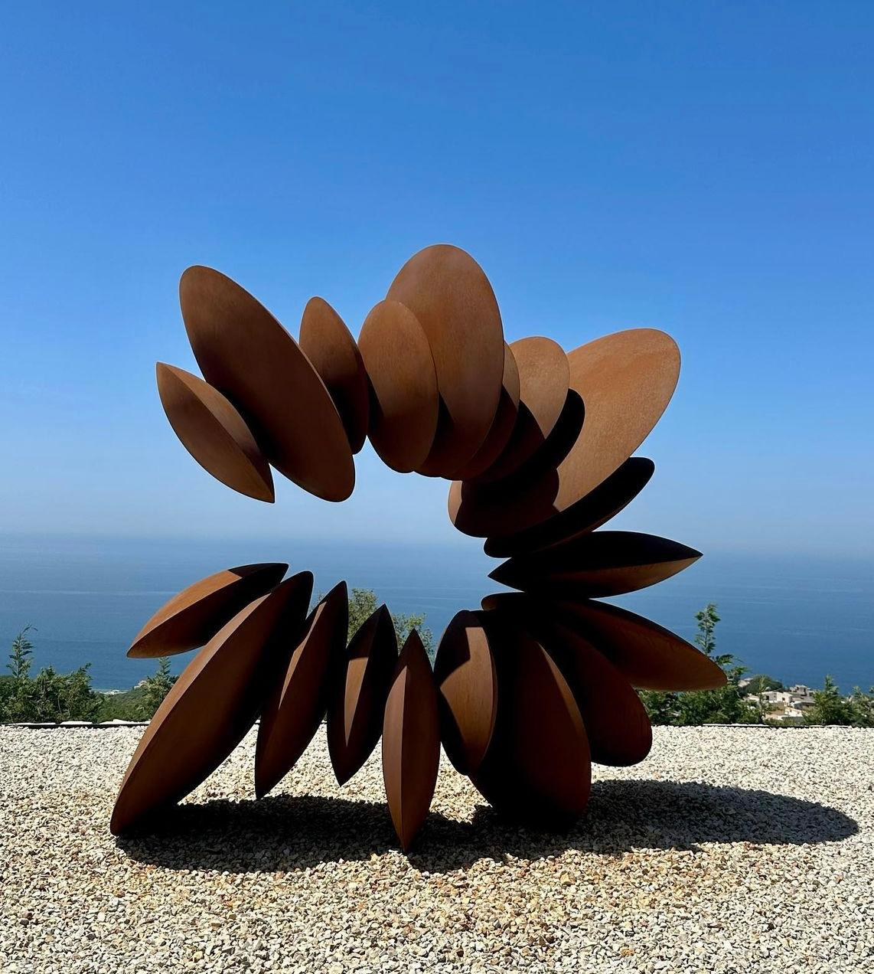
Moving to Anachar Michel Basbous we can clearly see his father’s love towards the village because if you spell “RACHANA” backwards you’ll find his name.
Moving to Anachar Michel Basbous we can clearly see his father’s love towards the village because if you spell RACHANA backwards you’ll find his name. ANACHAR
Anachar transformed Rachana from a forgotten village on Lebanon’s map to a shining village on the world’s map.
Last summer he inaugurated a huge museum at Rachana called “MAB”.
In fact, lots of his sculptures are now in different countries such as Saudi Arabia and France.

Slide 10
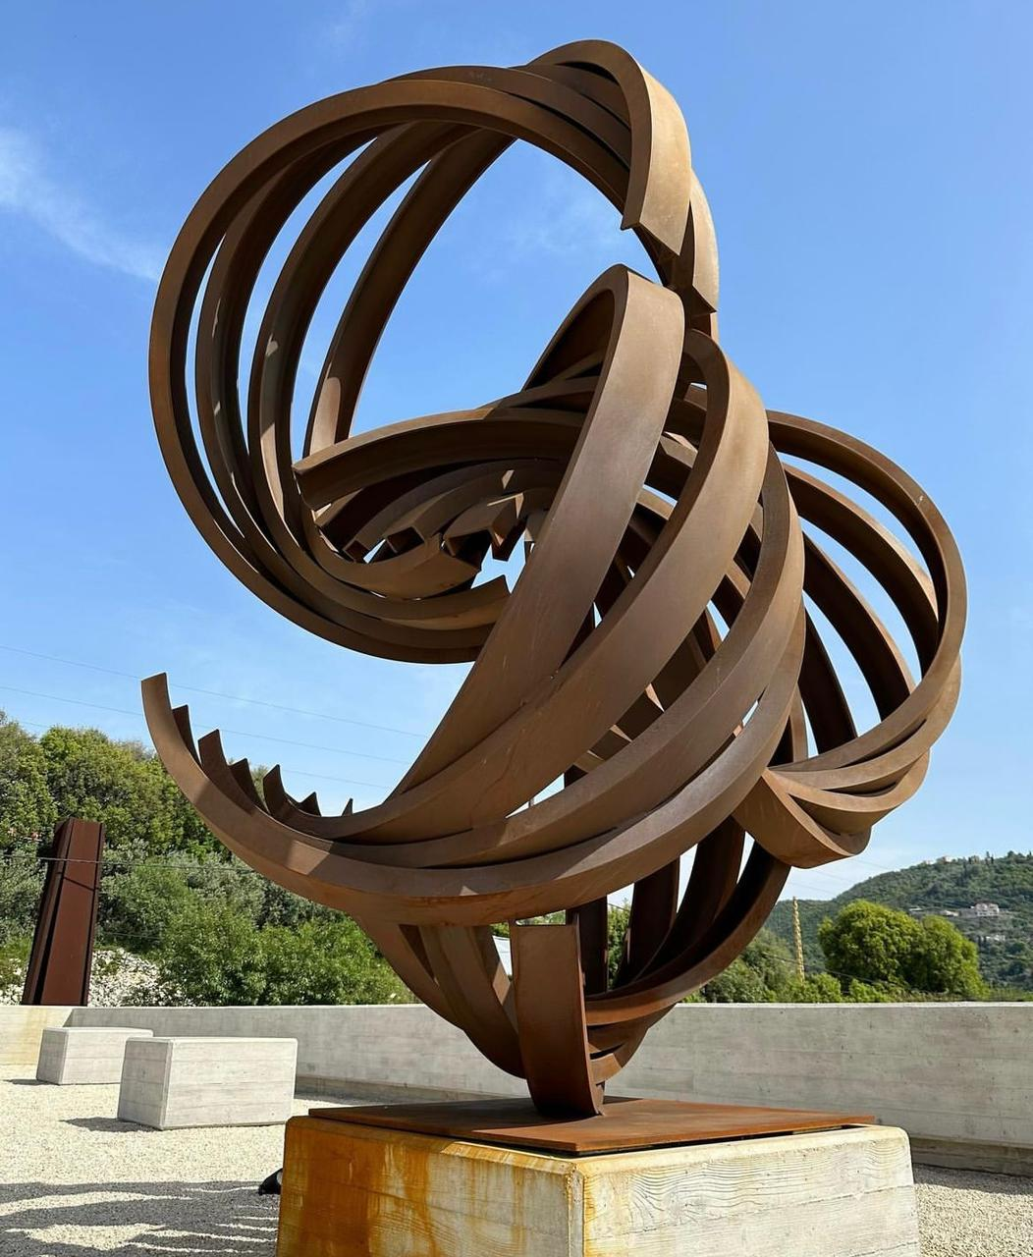
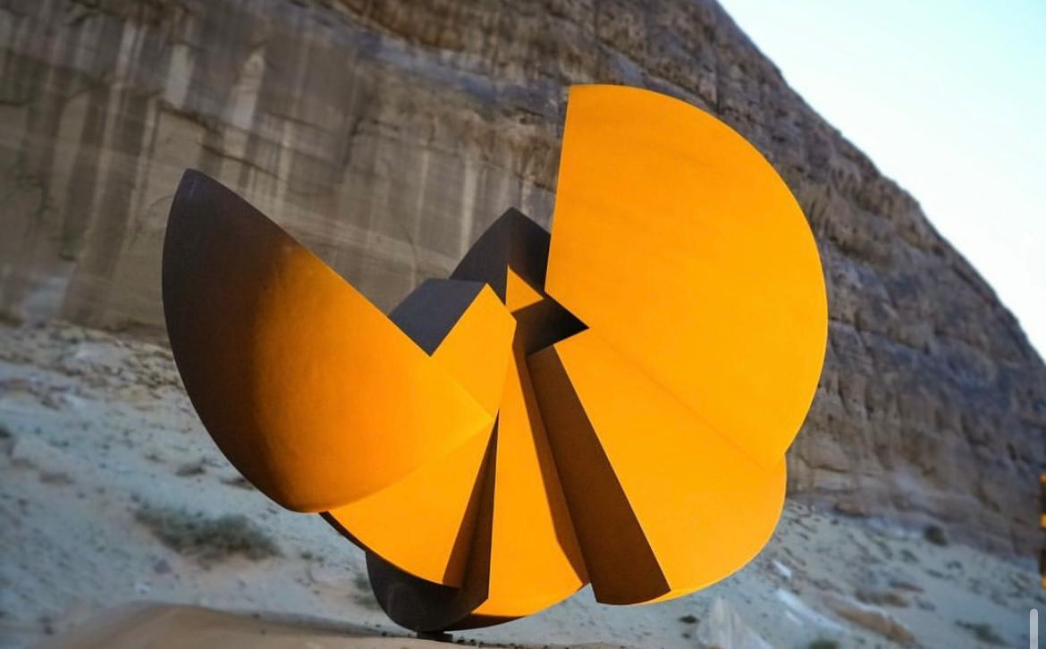
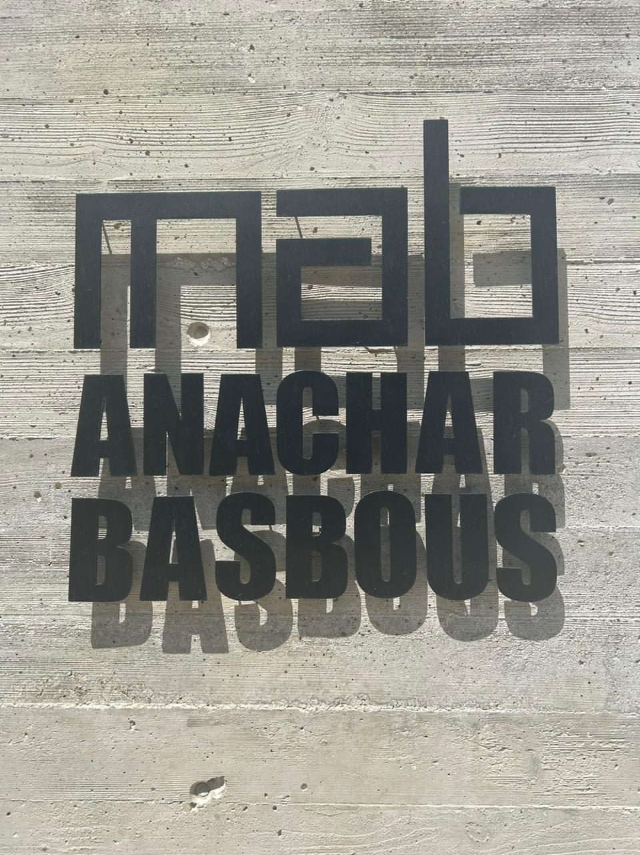
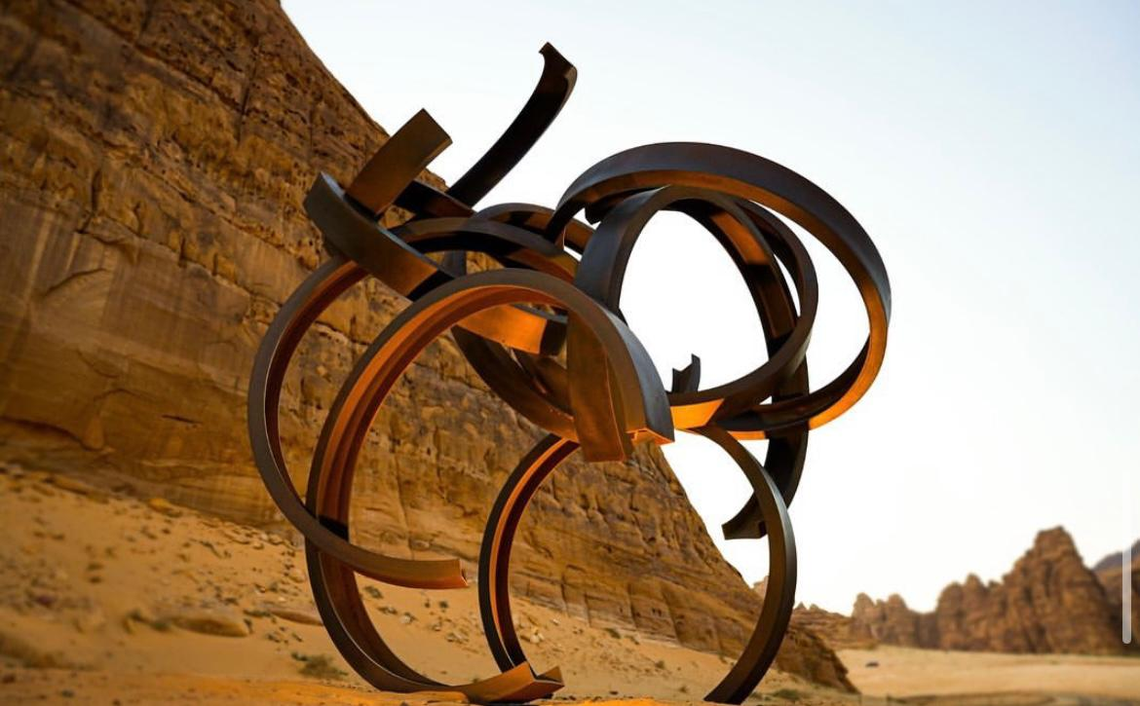
Anachar
His sculptures at Saudi Arabia
MAB

Slide 11
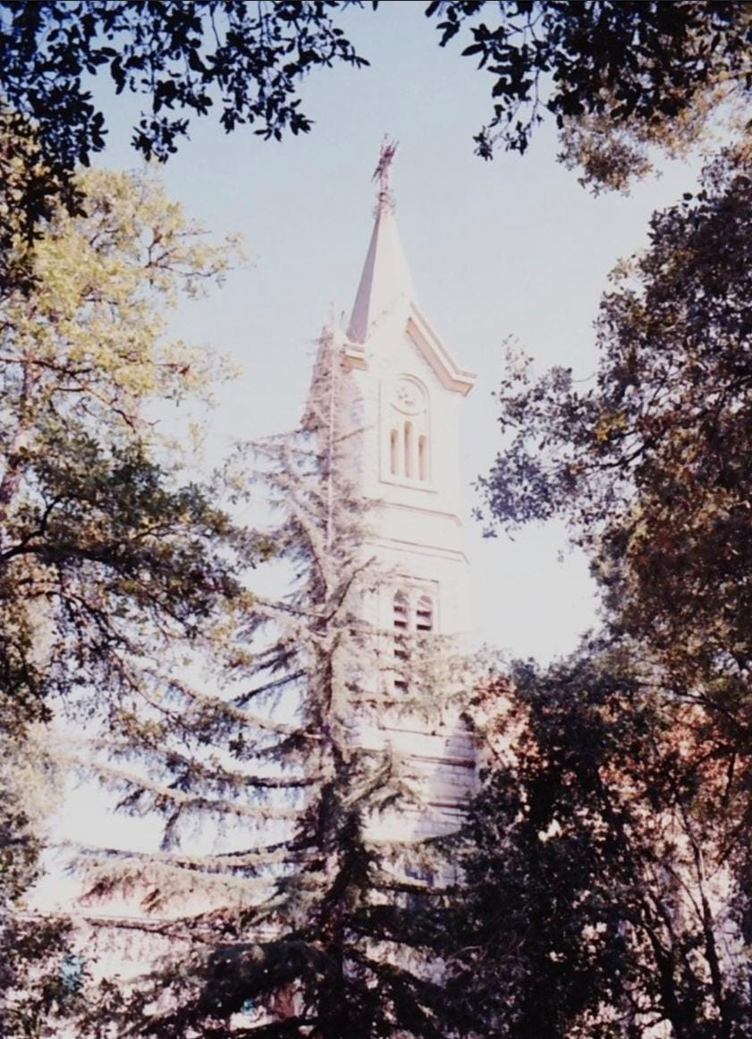
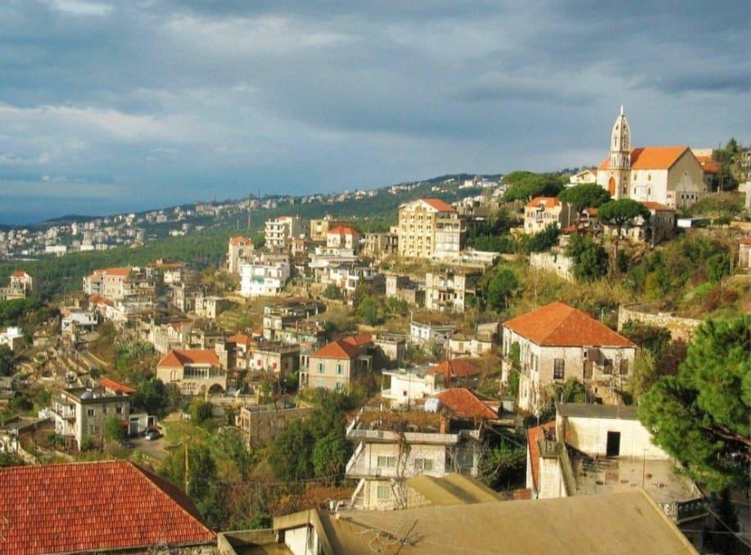
Beit Chabeb
Beit chabeb is one of the largest villages in the Metn, and yet it has preserved its traditional aspect and craftsmanship through the generations. This well wooded village, surrounded by a beautiful pine forest, is characterized by its many traditional houses and old churches, such as Saydet el ghabeh which dates back to 1761.

Slide 12
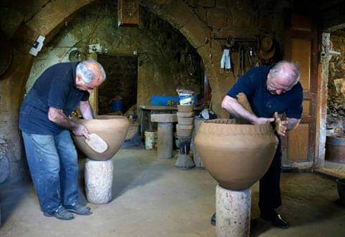
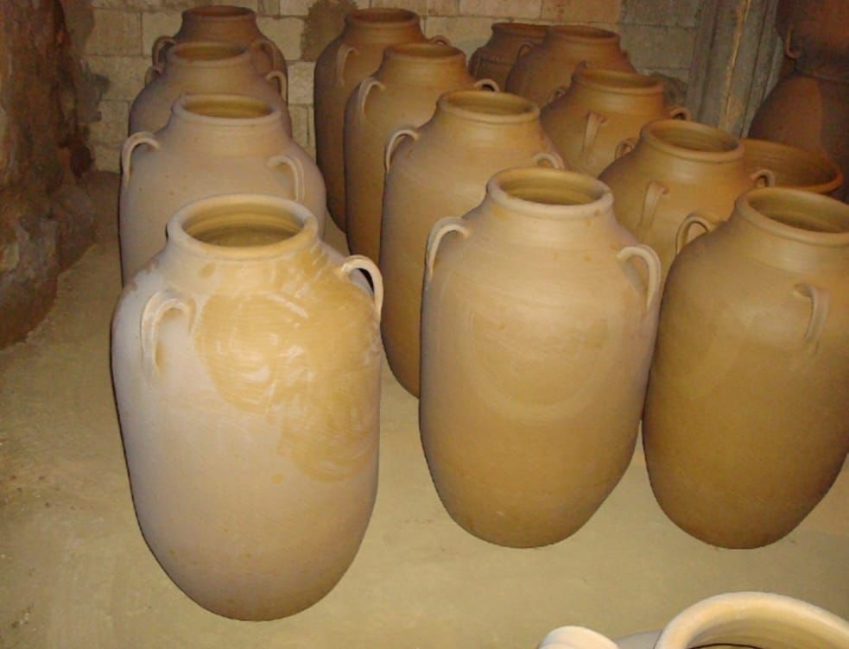
Beit chabeb is particularly famous for its traditional crafts of pottery.
Fawzi Fakhoury, a 76 years old man, is the last working potter in Beit chabeb. He left works with his brother Assad who helps out occasionally in the shop.
Sixty years ago, dozens of Beit chabeb families produced traditional pottery, and the heat from 40 burning ovens could be felt on the streets during summer, Fawzi explains.

Slide 13
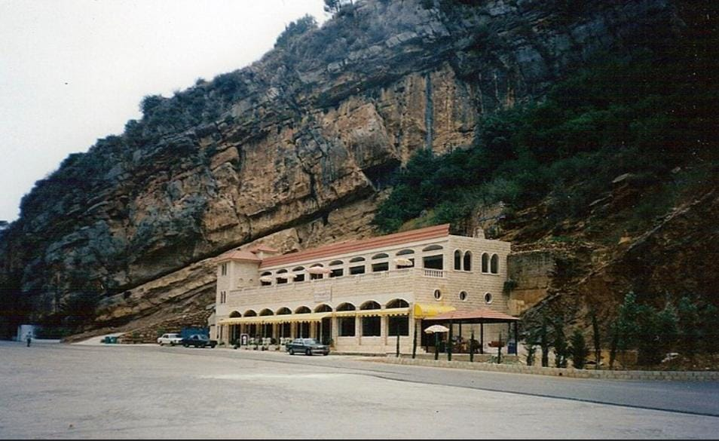
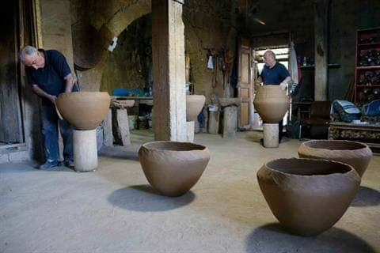
The town’s name synonymous with pottery, and people came from around the country to purchase the artisanal clay pots, used for storing everything from Arak to grains, olive oil and wine. Nowadays, Fawzi is the only one left and Fakhoury’s workshop resembles a hermit’s cave.

Slide 14
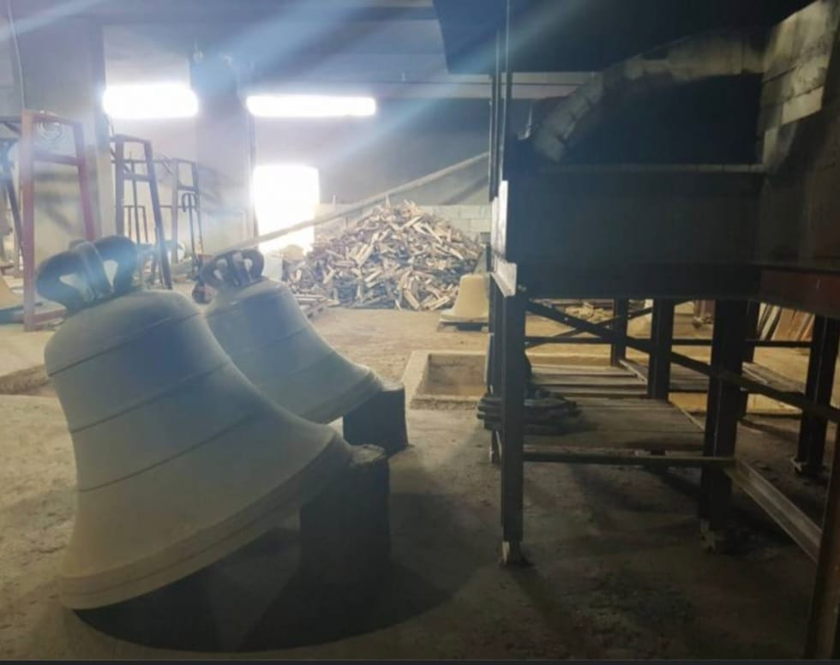
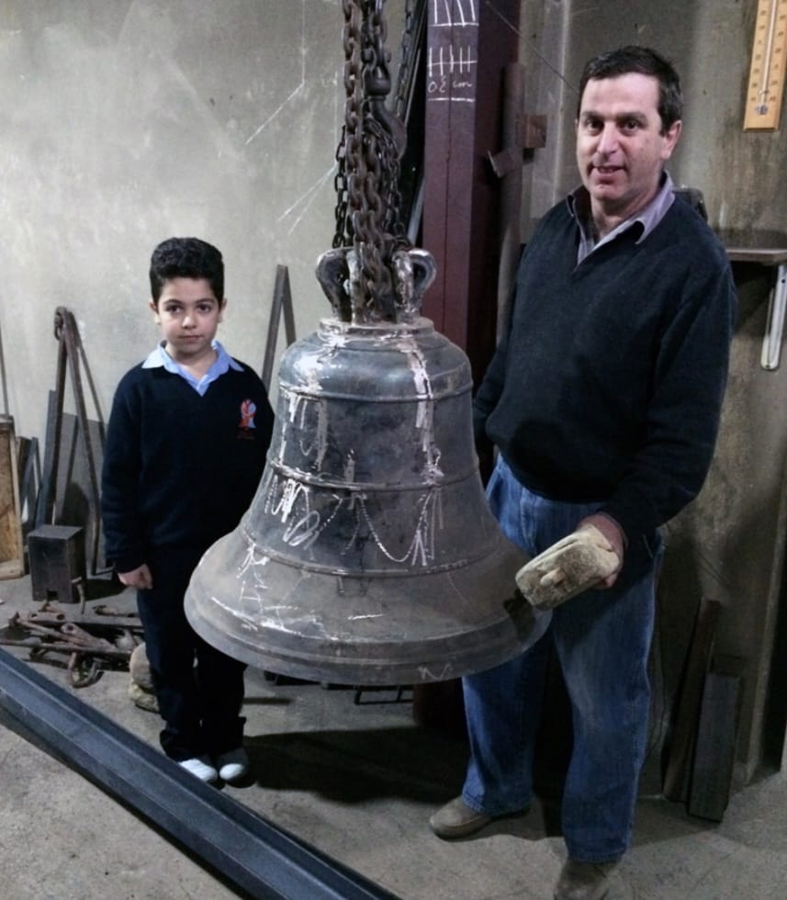
Beit chabeb has became a renowned region center for the bell-making trade, thanks to skills of the Naffah family.
Their handmade bells are highly sought-after and can be found in churches throughout Lebanon.
We can also find their bells in Syria, Jordan, Egypt, Iraq and Palestine.

Slide 15
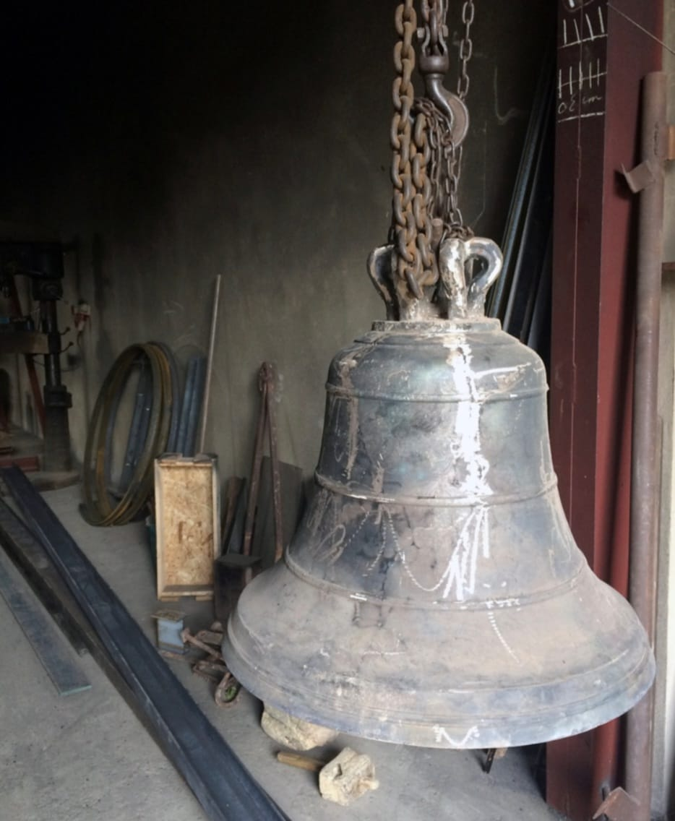
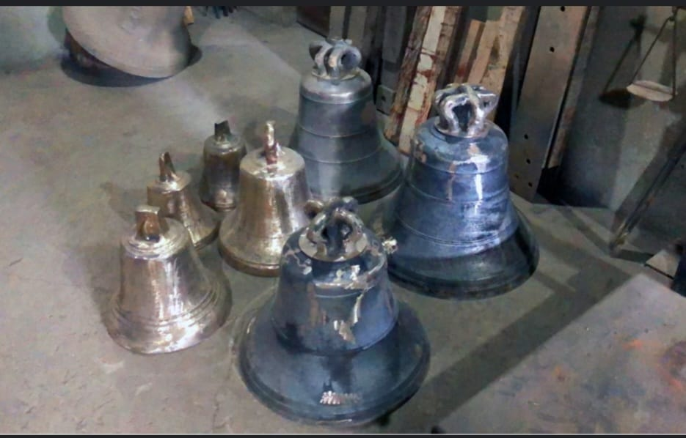
Role and origin of the bells.
At first, small bells were used during Masses, similar to those used in pagan rituals. The first evidence we have is that bells were used to summon the faithful to Mass comes from the sixth century. The tradition of ringing bells before Christian services, then dates back at least 1500 years and likely originates from Africa.

Slide 16
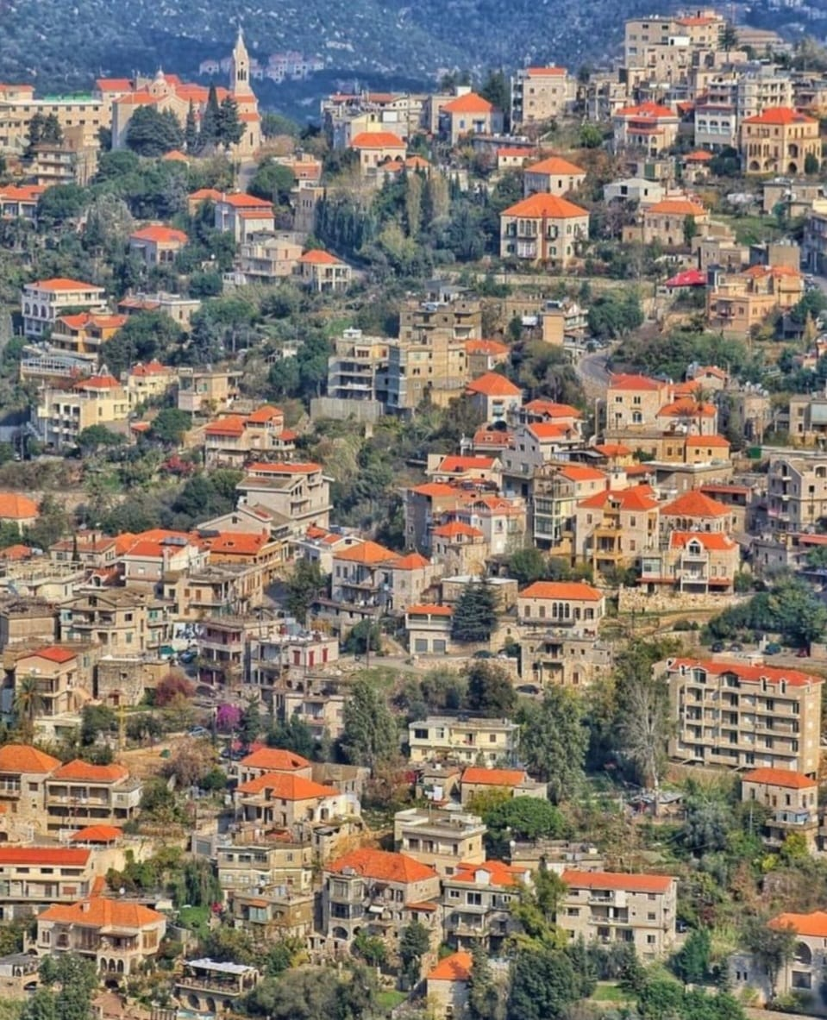
Fun fact
Regarding houses at Beit chabeb, traditionally, they had been large, hall-like spaces and all of the roofs are covered with tiles.

Slide 17
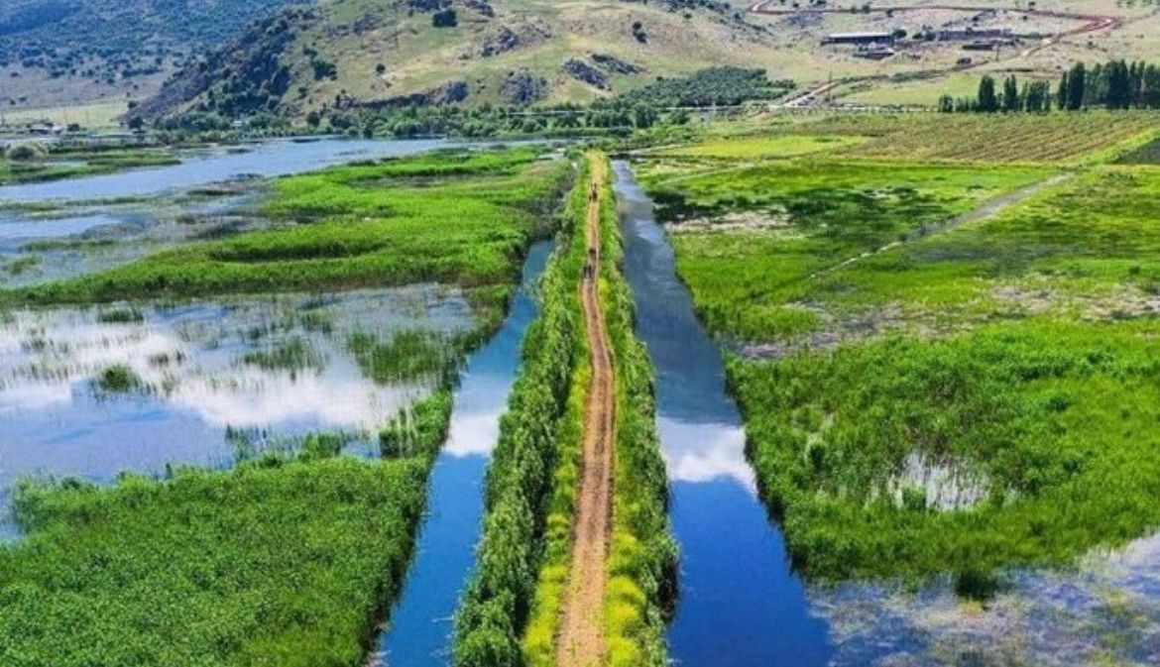
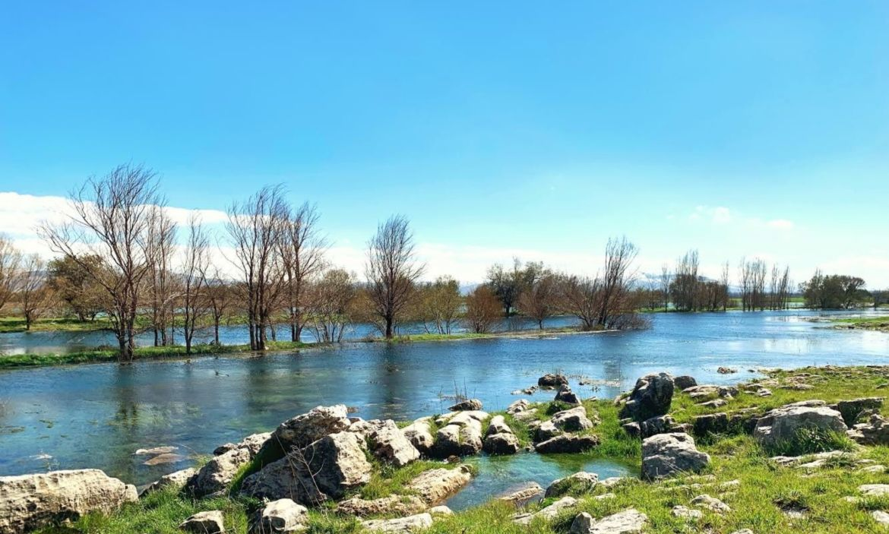
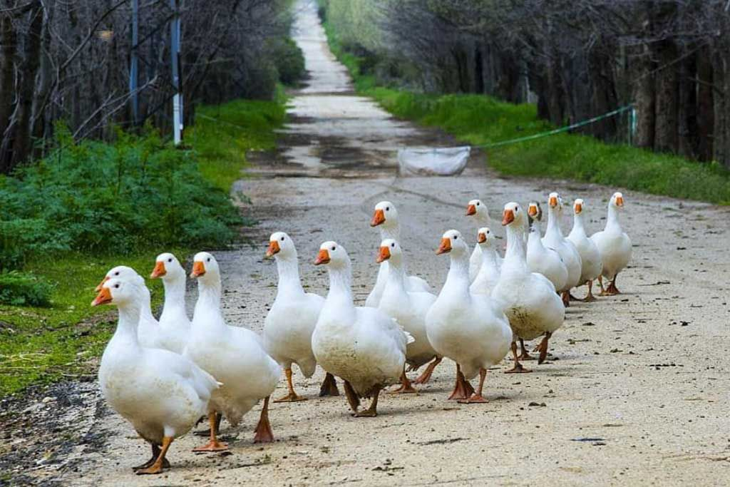
AMMIQ
Arriving to Ammiq, located in the west Bekaa between two mountain trails. Ammiq is considered as the last and largest remaining significant wetland in Lebanon. The international bird organization considered Ammiq as an important region for immigrant birds because we can find more than 250 types of birds , among them lots of birds in extinction.

Slide 18
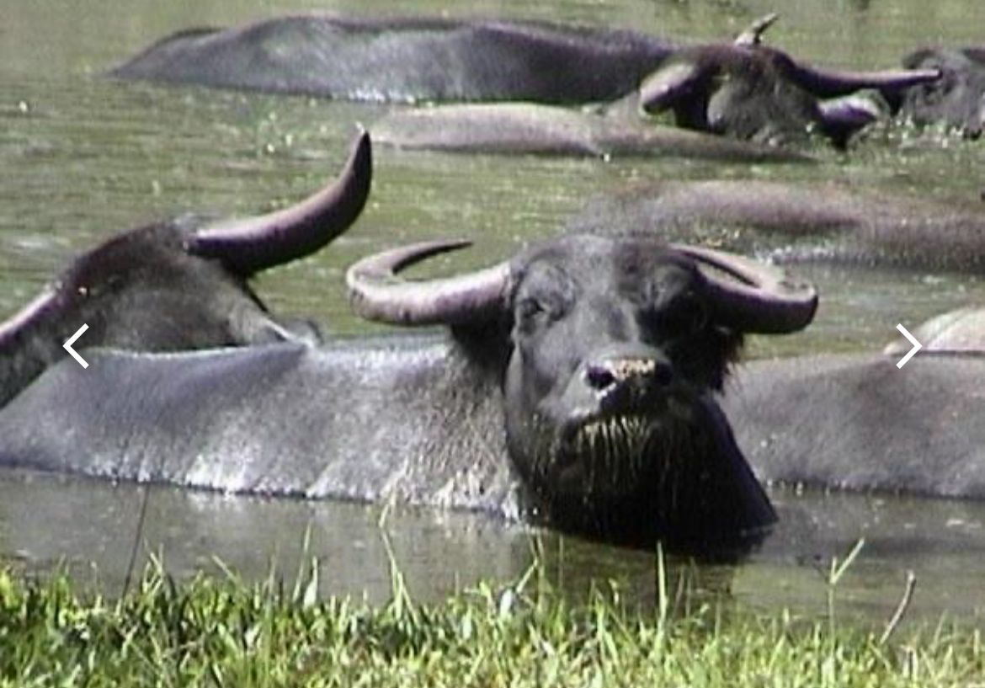
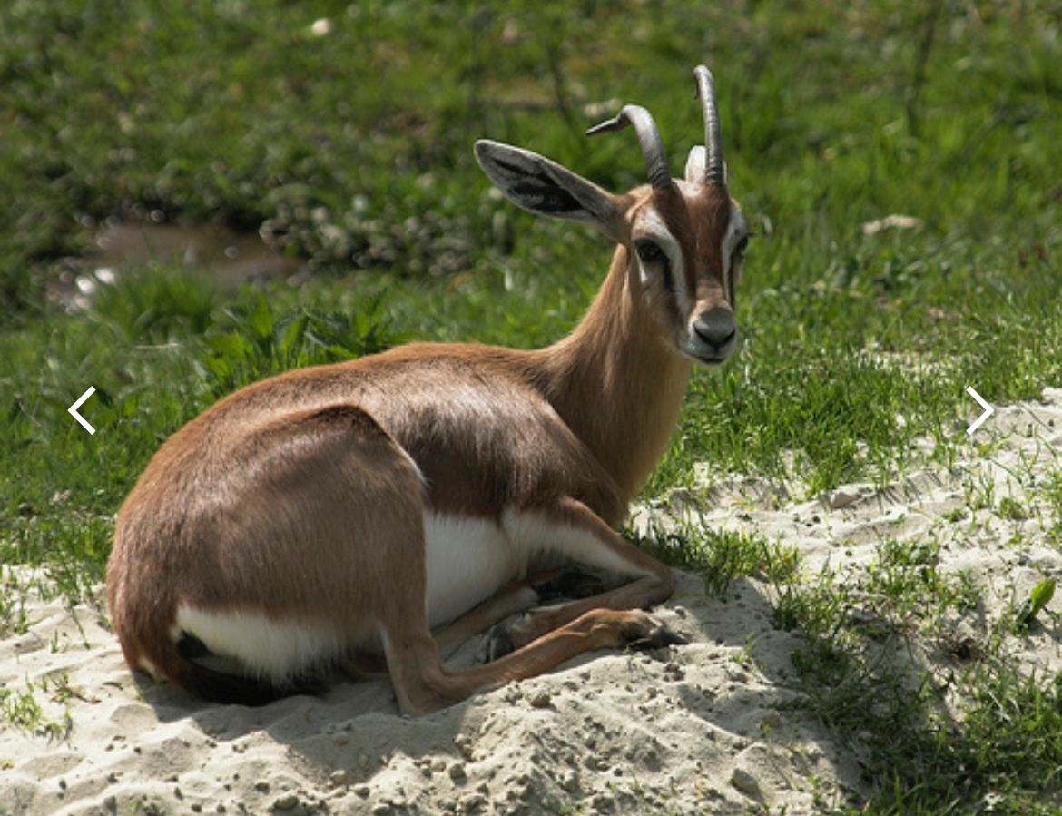
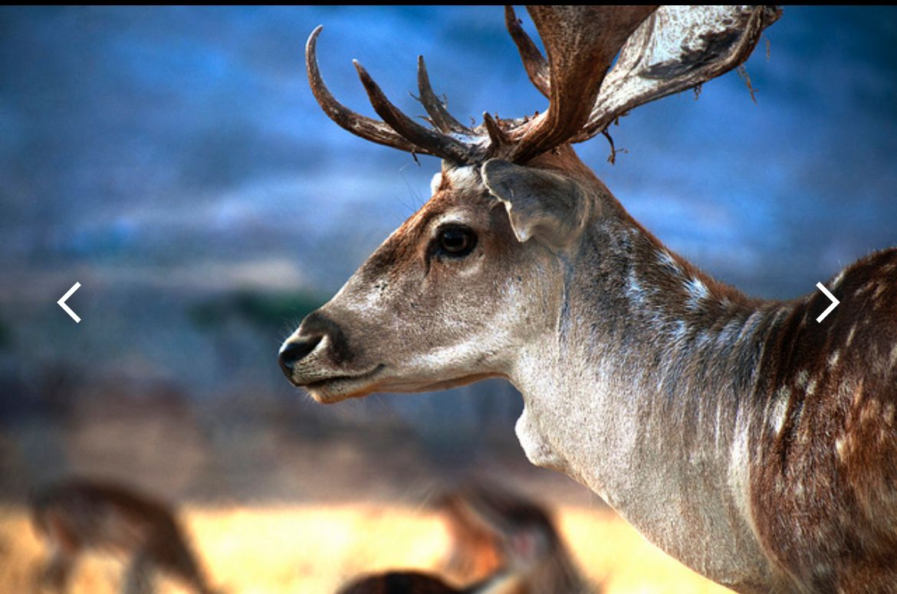
In addition to birds, there are unique types of animals such as:
Mountain gazelle
Also, bubalus were brought to the wetland in order to preserve vegetation. Those bovians eat harmful herbs.
European fallow deer…

Slide 19
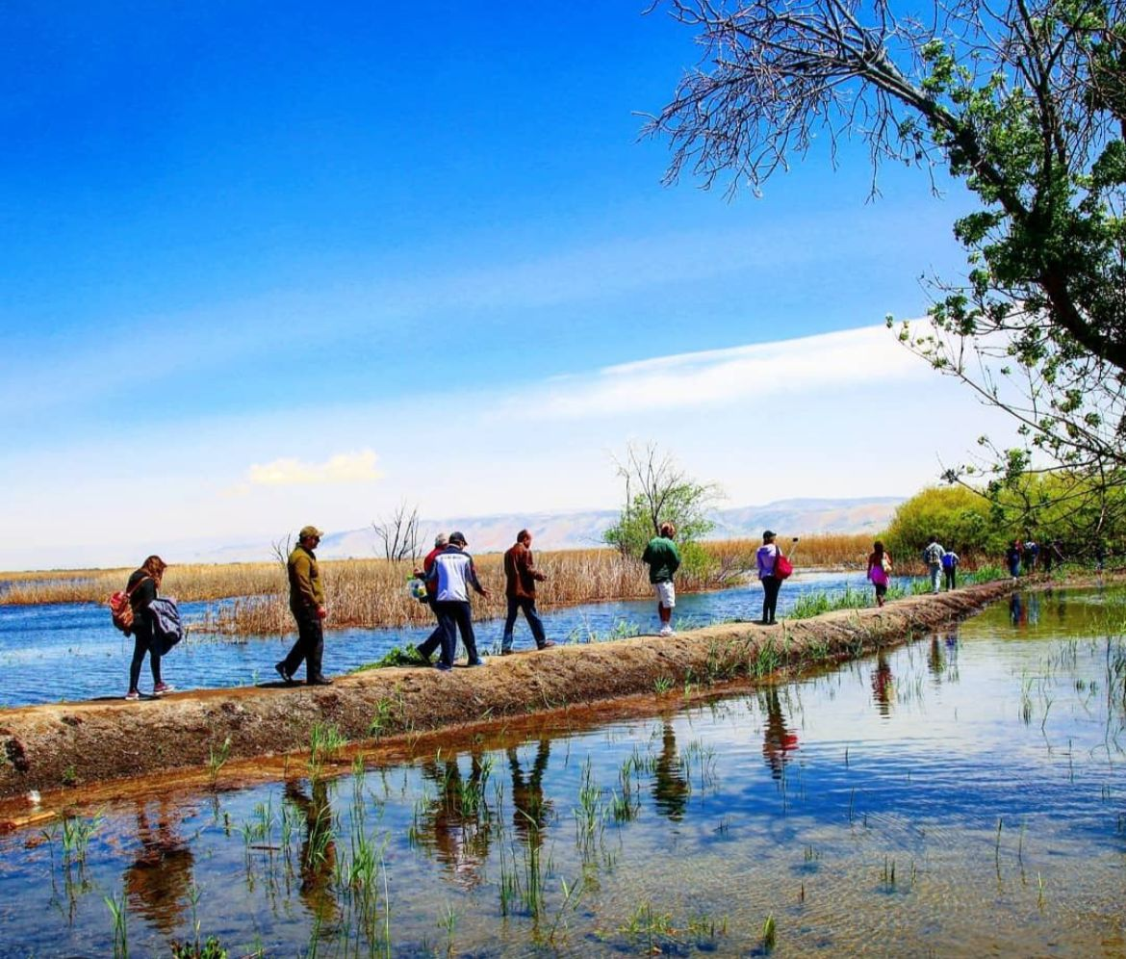
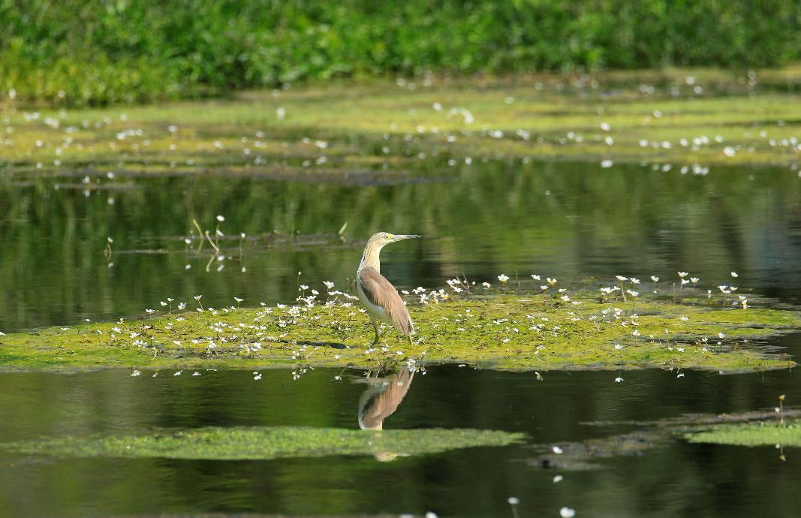
Concerning activities at Ammiq:
A lot of tourists visit Ammiq to hike and enjoy the amazing view.
Others visit Ammiq to enjoy birdwatching.

Slide 20
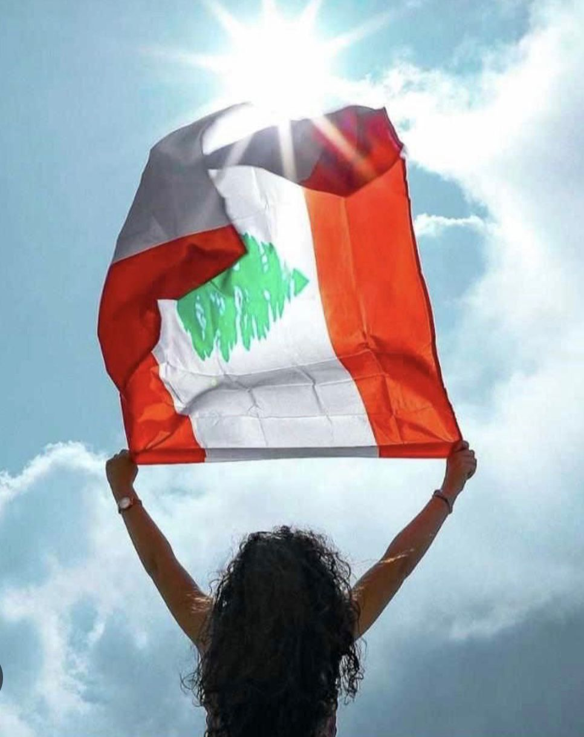
As a moral of this presentation, let’s look at the full half of the glass. Despite all the troubles Lebanon is facing, it still has it’s own and unique beauty. So never lose hope, because our Lebanon will always shine from its north to its south.
Hope is being able to see that there is light despite all of the darkness.
Thank you for your attention!

